Slide 1

Transit Vision
Stakeholder Meeting #2
November 13, 2017
Justin Entzminger and Suzanne Carlson, Innovate Memphis
John Zeanah, City of Memphis
Scudder Wagg, Jarrett Walker + Assoc.
Notes:
This is a Committee, not just a come-and-go series of meetings. We want your help setting policy, at a level that requires training, time, thought, debate and compromise. Ambassadors!
You are in a different position than a member of the public, who may take a survey or come by an Open House.

Slide 2
Agenda
Welcome and introductions
Review last meeting
Review public input
Discuss the four Concepts
Preliminary polling
Information on next steps
Notes:
Have them mix up their groups

Slide 3
Open your browser
Go to www.rwpoll.com
If you need WiFi
Network: WildFire
Password: accessemergeNOW
Session ID:
659990

Slide 4
Interactive Polling
I’m going to ask you some multiple-choice questions.
Push the appropriate button on your device.
If you change your mind, just push a new button.
Notes:
Why?
--To know what the room thinks, right away, so we can discuss it
--If you’re a little quiet, so I and others know what you think
--If you have an opinion that you think might be unpopular….

Slide 5
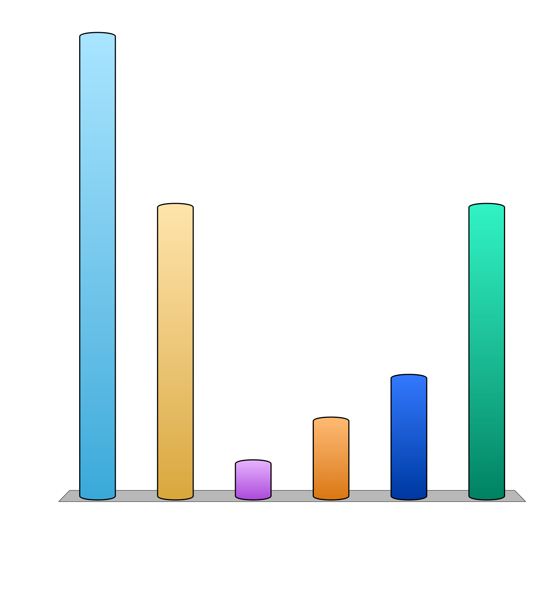
Test: What is your favorite vowel?
A
E
I
O
U
Sometimes Y

Slide 6
Existing Conditions and Key Choices in Memphis

Slide 7
Performance measure: coverage
What % of people and jobs are within walking distance of transit?
How many residents have access to at least some service?

Slide 8
How many Memphis residents have access to any service? What about frequent service?
What about jobs?

Slide 9
Performance measure: ridership
How much “bang” are we getting for our “buck”?
How relevant is transit to the economy and the life of our city?

Slide 10
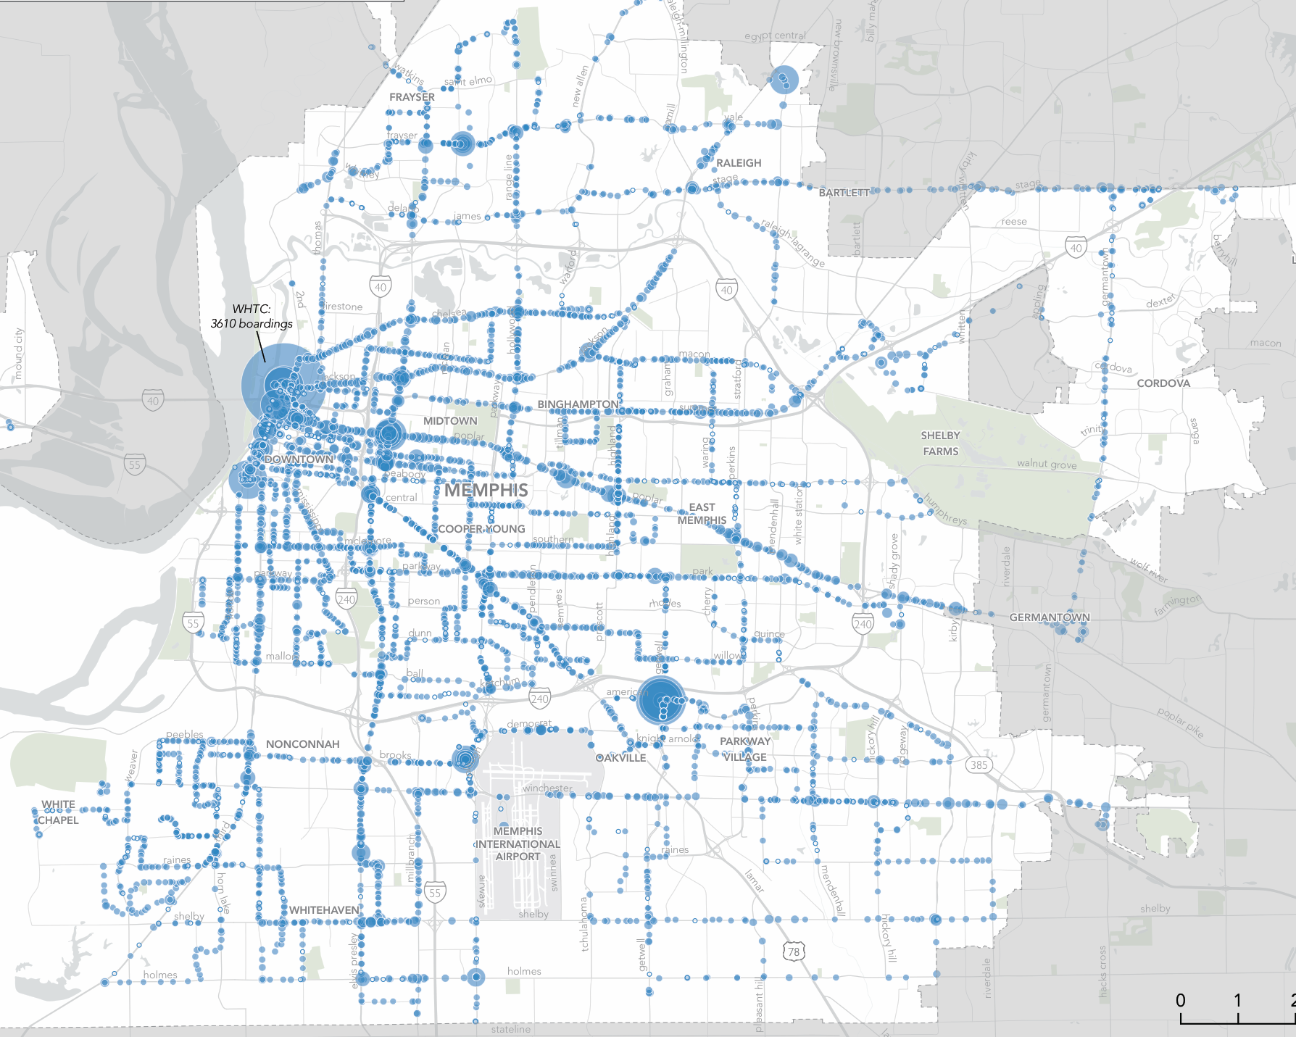
Ridership

Slide 11
How should we measure ridership?
Ridership relative to cost =
Boardings per hour of service =
“Productivity”
for example, “10 boardings per hour”

Slide 12
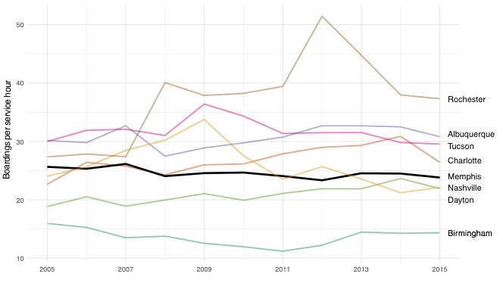
System-wide productivity, among peers

Slide 13
Productivity and frequency relate, in Memphis...

Slide 14
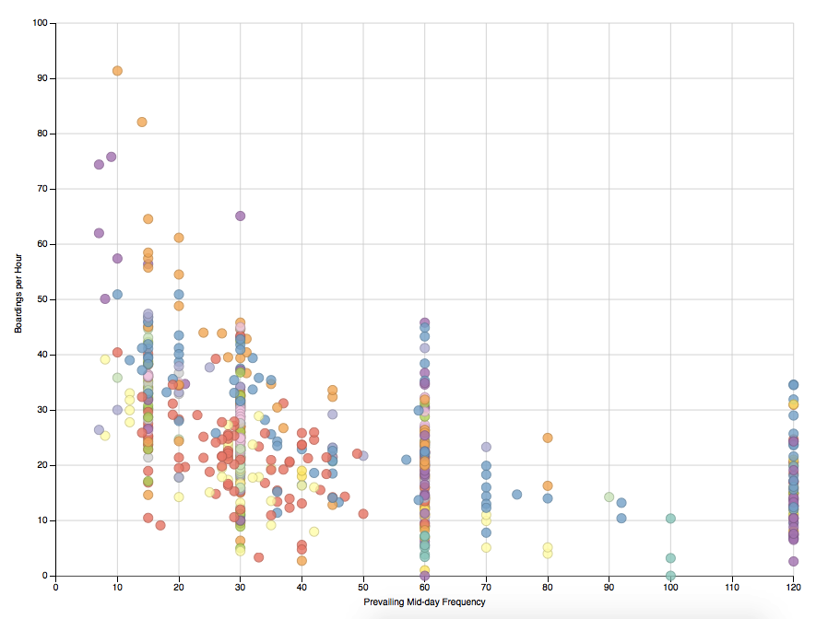
…and everywhere else.

Slide 15
Why does frequency matter so much?
Notes:
Waiting time – not just at the bus stop
Technology helps only a little bit
Reliability
The ease of a road, always there when YOU want to go

Slide 16
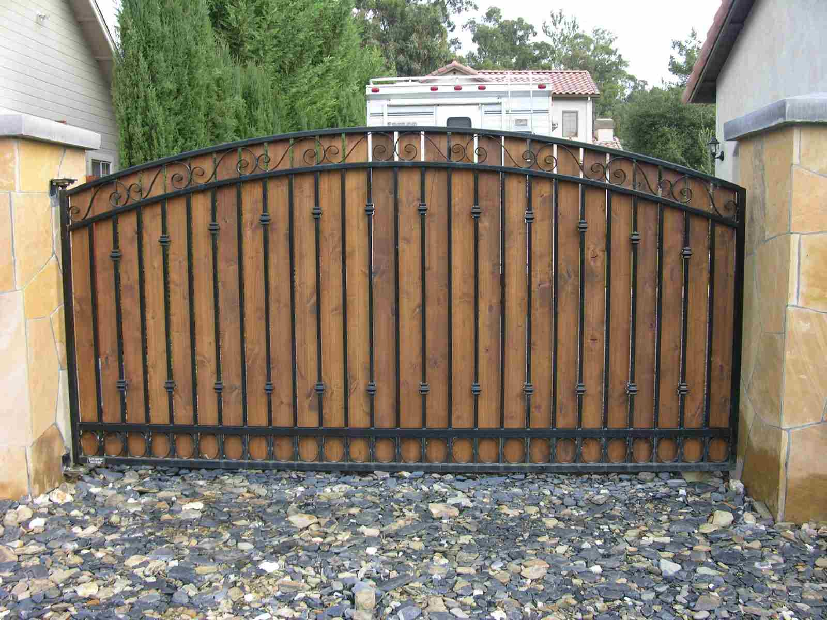
Low frequency is hard to imagine if you don’t use transit much.
Elevators?
Traffic signals?
A gate at the end of your driveway that opens only once an hour???

Slide 17
The “Ridership Recipe”
If high ridership is what you want, then you should follow…

Slide 18
Frequent, long-span service …
Following patterns of …
  Density
  Walkability
  Linearity
  Continuity
…and forming a connected network.

Slide 19
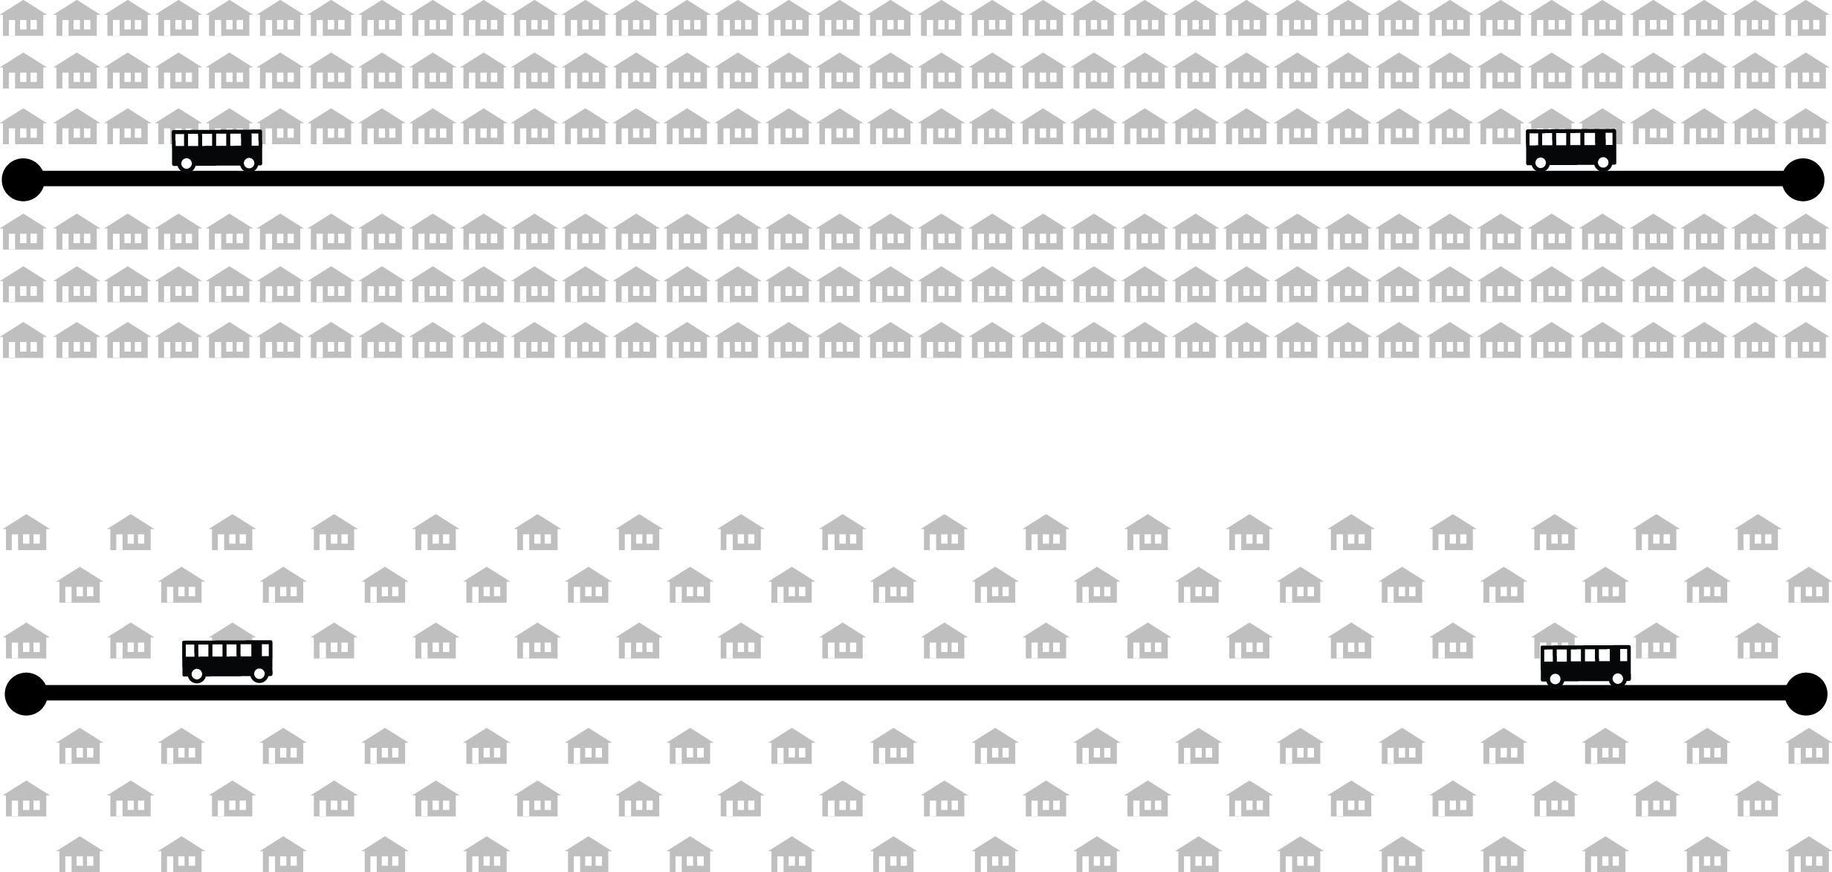
Density
How many people are going to and from the area around each stop?
Higher Ridership
Lower Ridership

Slide 20
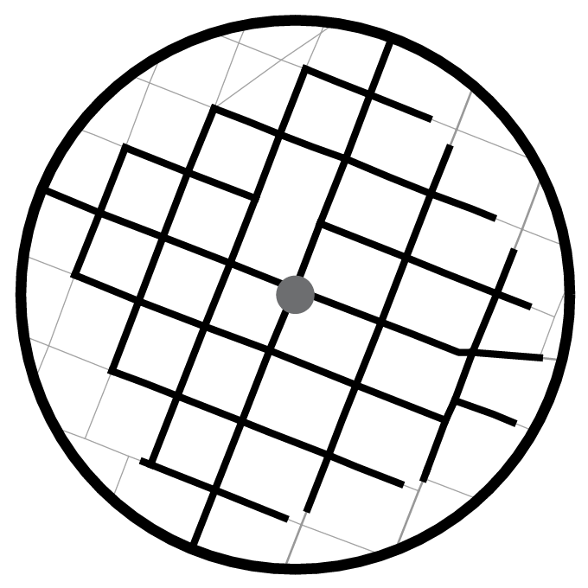
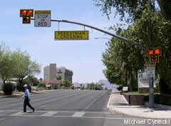
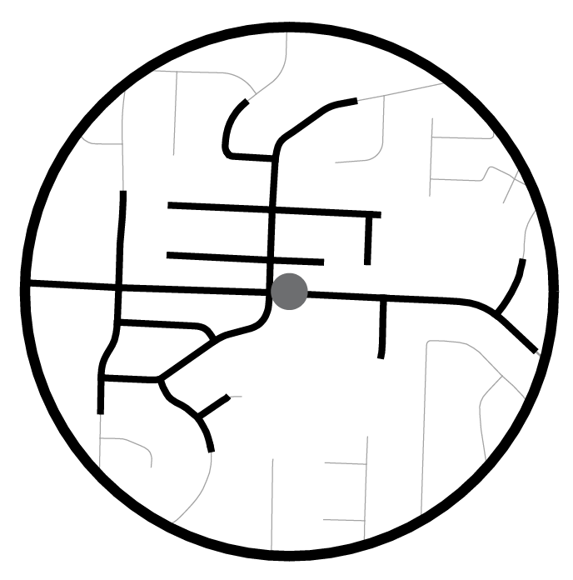
Walkability
Can the people around the stop walk to the stop?
Higher Ridership
Lower Ridership

Slide 21
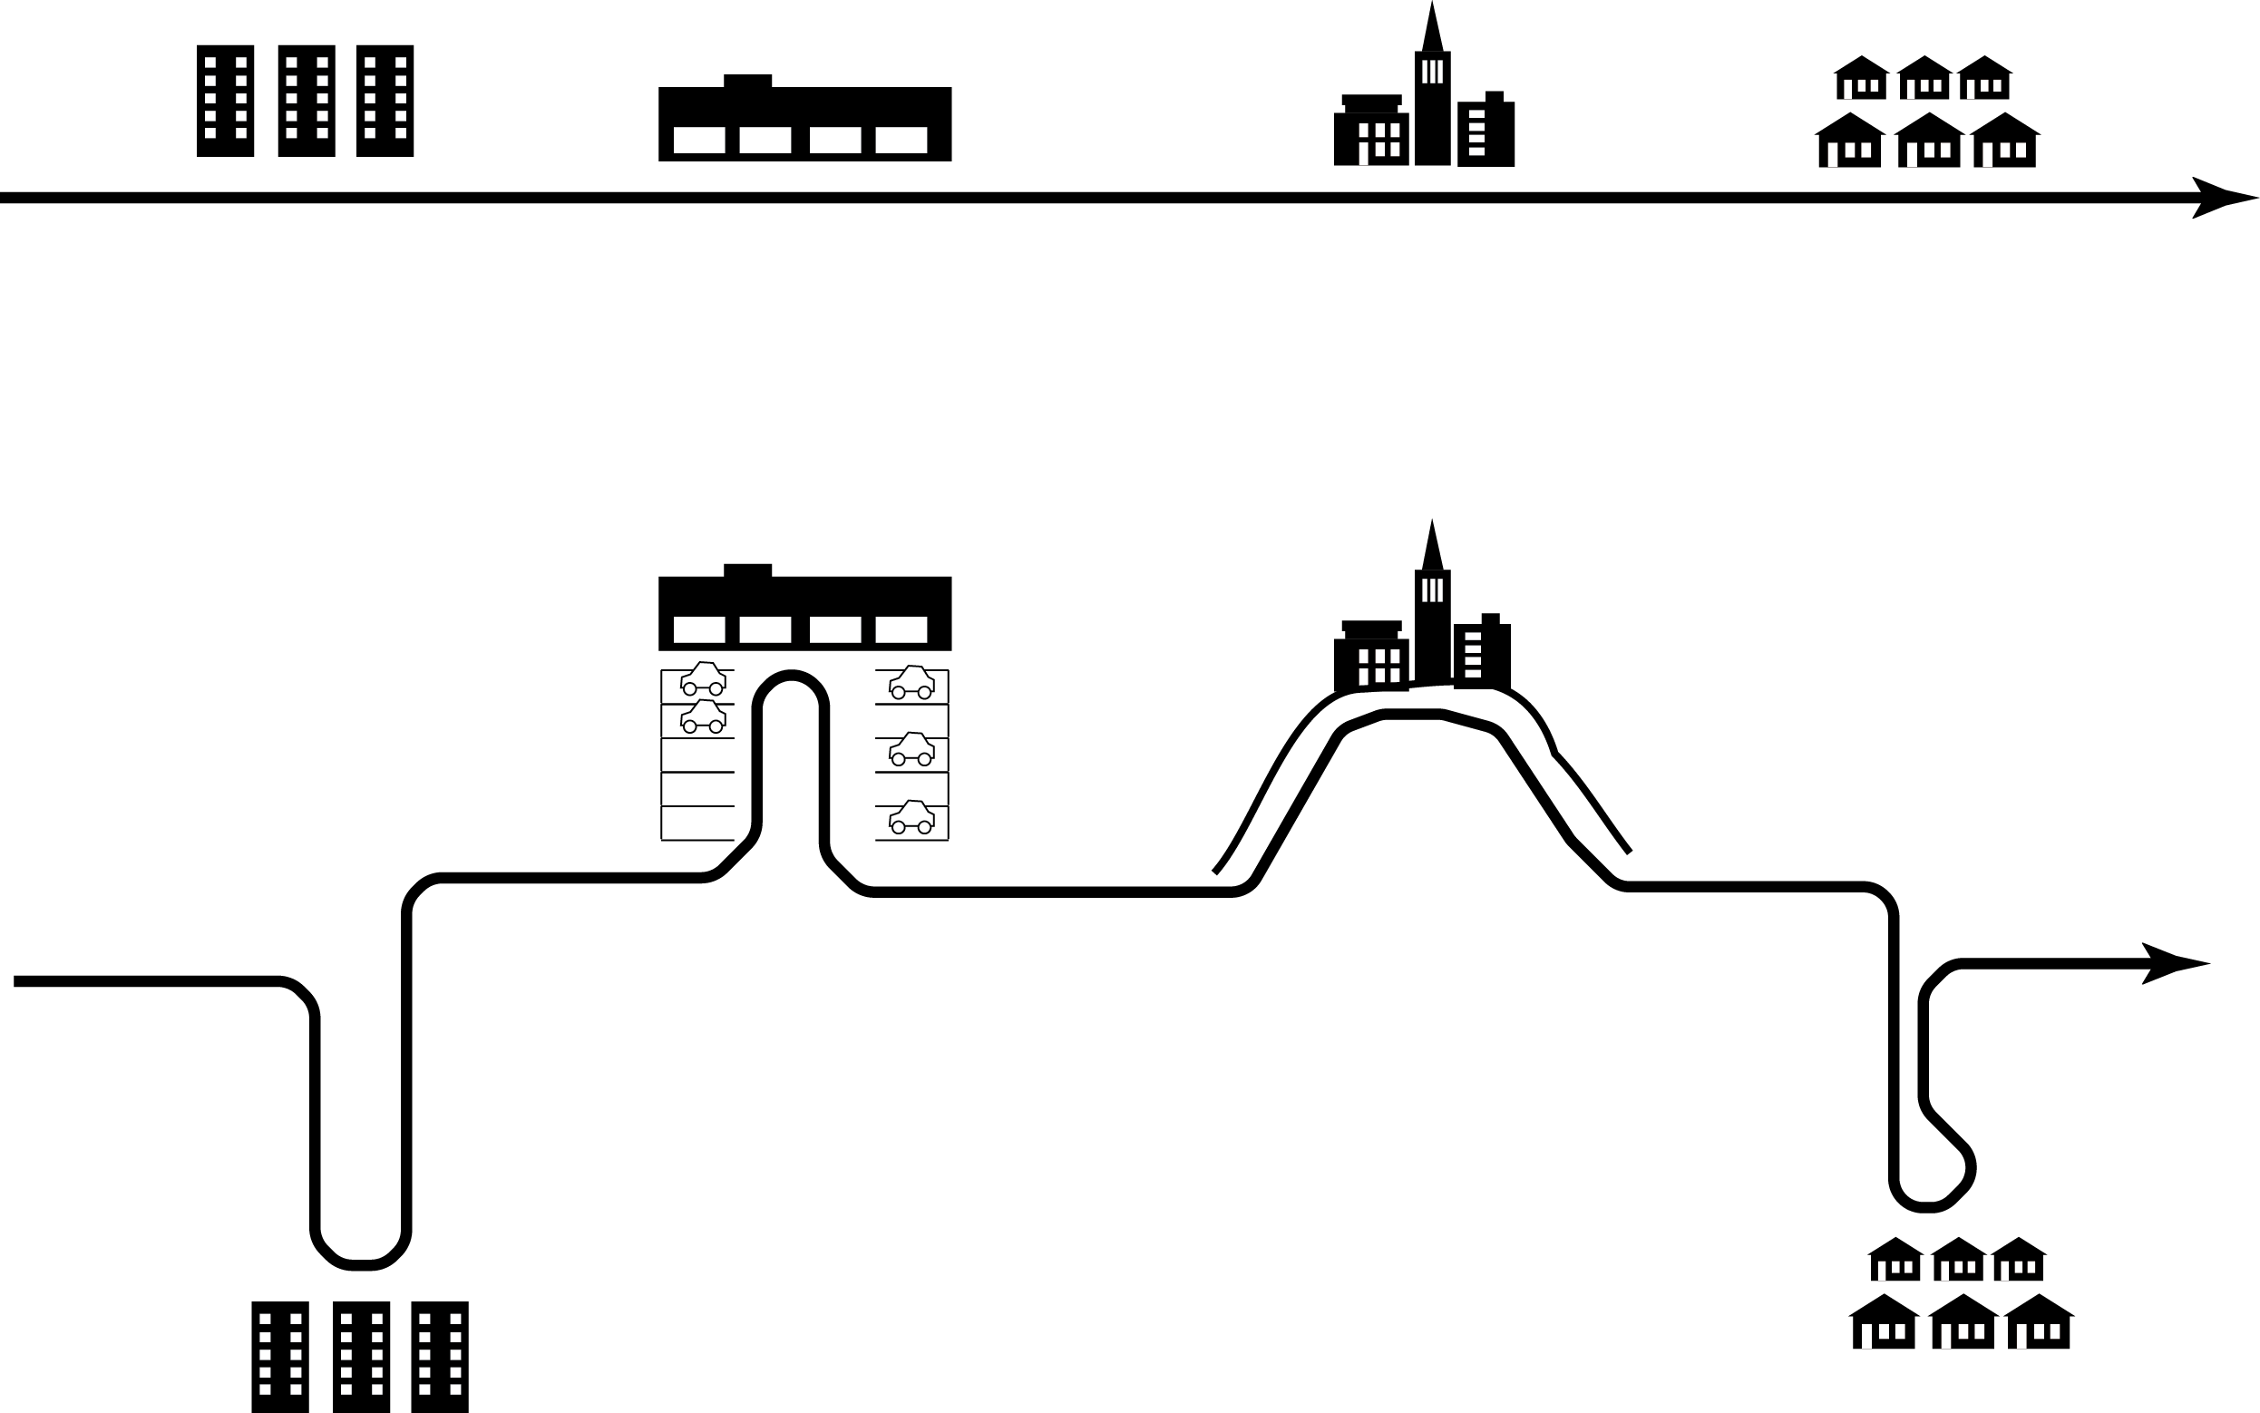
Linearity
Can transit run in straight lines that attract through-riders?
Higher Ridership
Lower Ridership

Slide 22
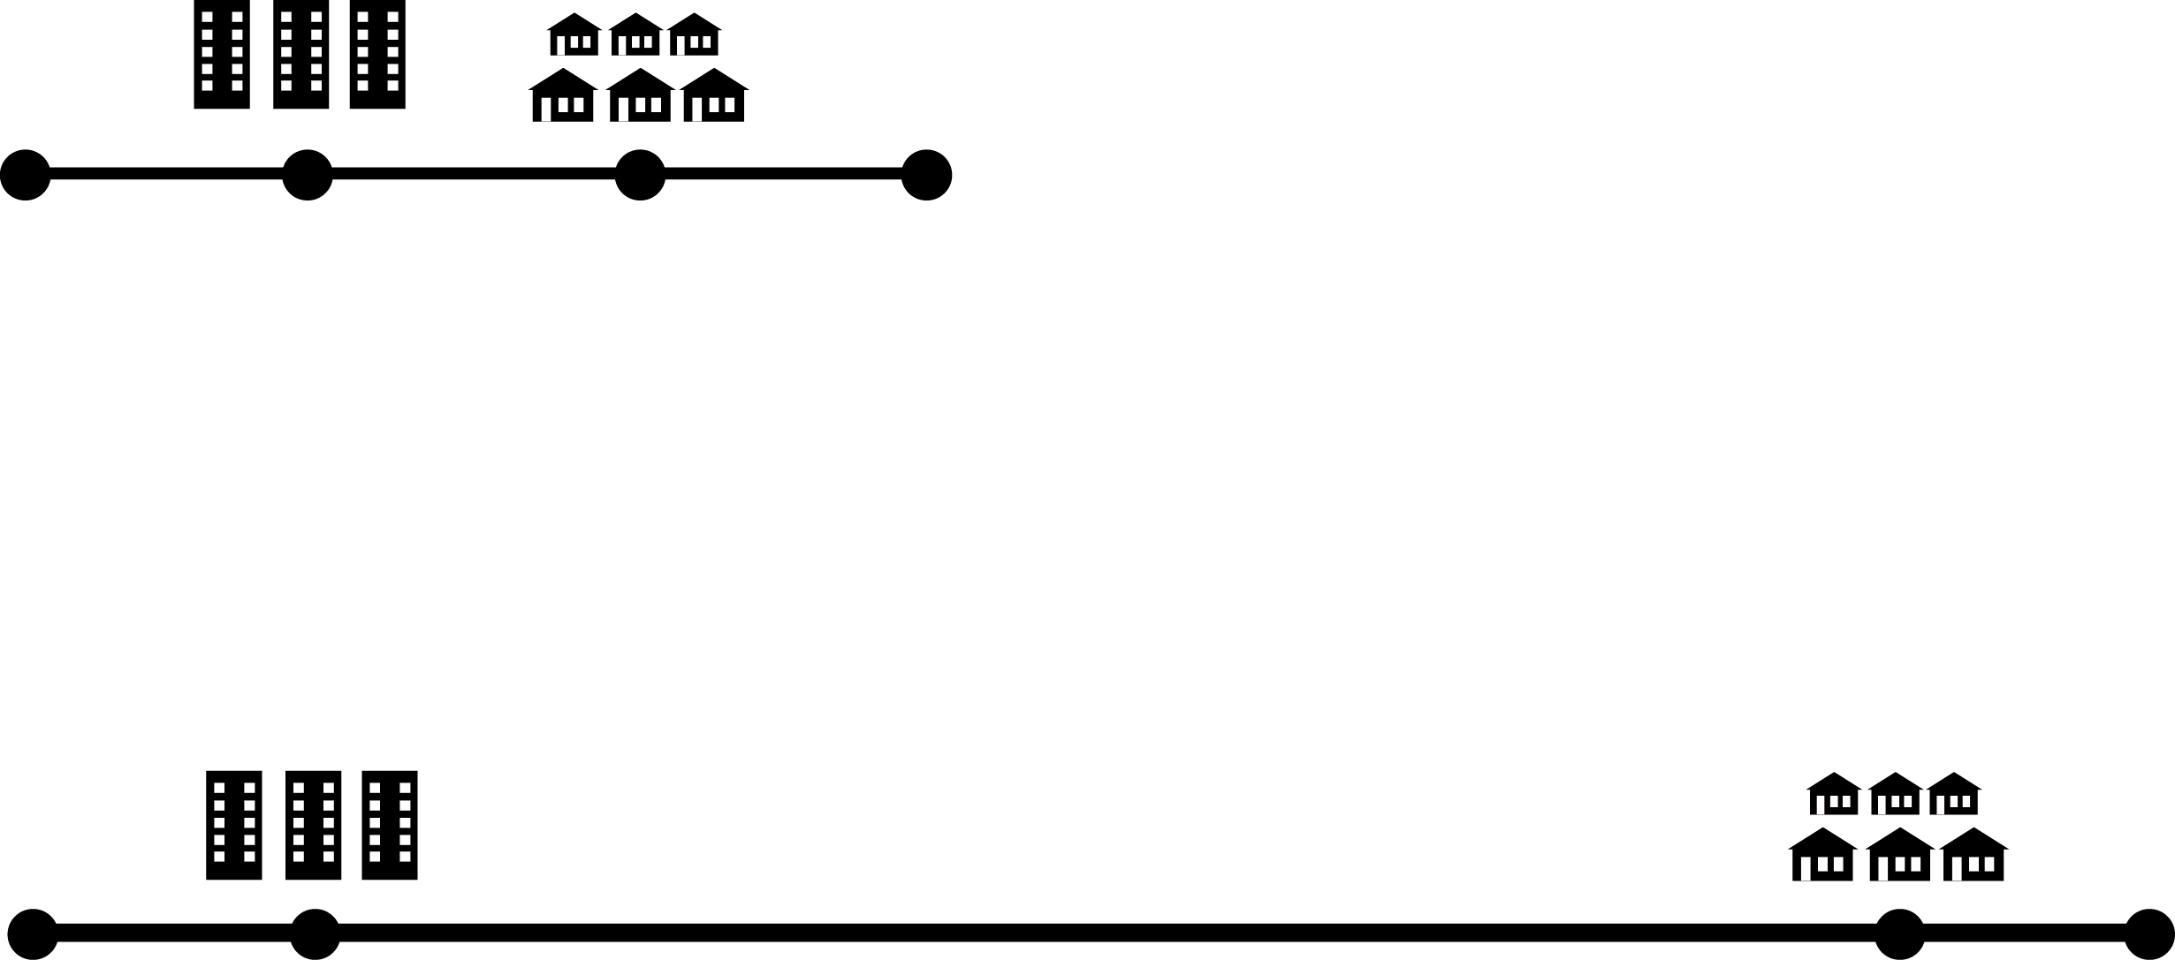
Proximity or, Continuity
Does transit have to cross long low-ridership gaps?
Lower cost
Higher cost

Slide 23
Memphis Planning Game

Slide 24
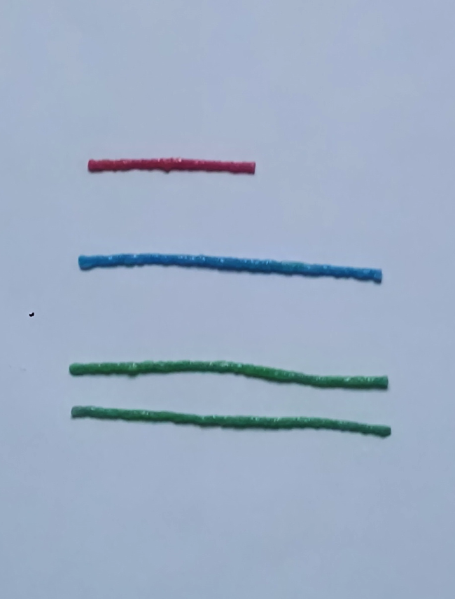


Slide 25
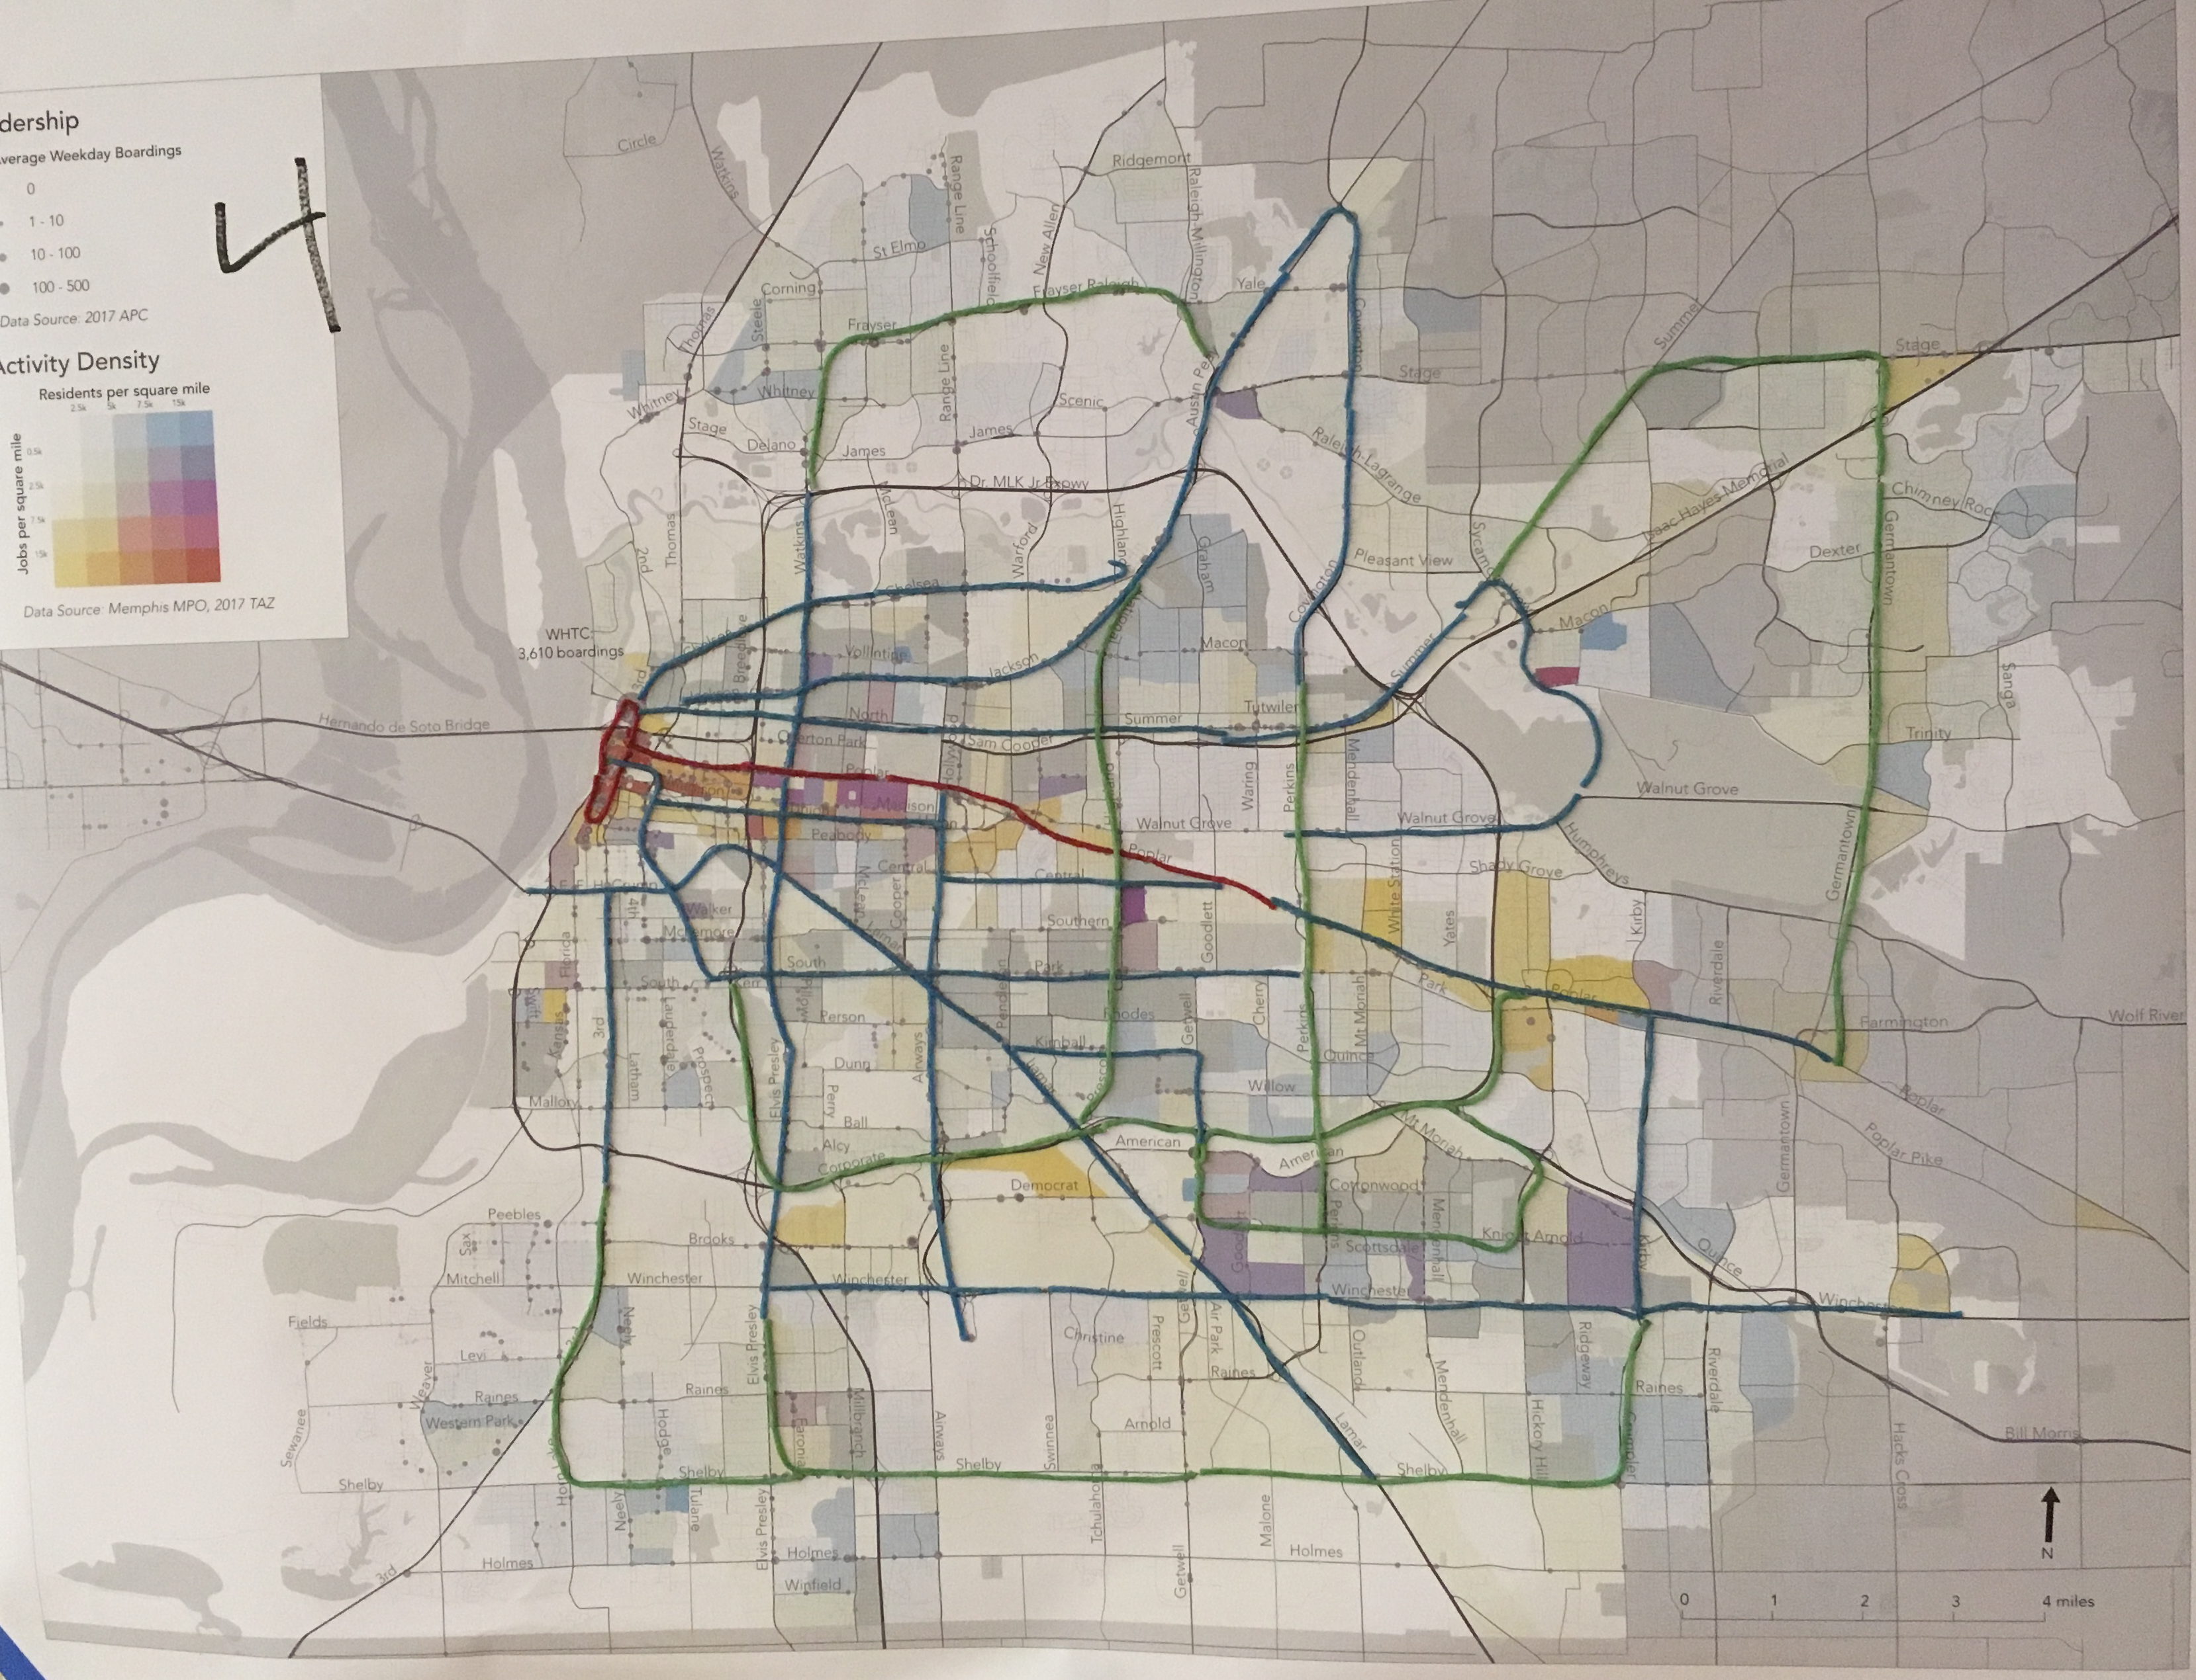

Slide 26
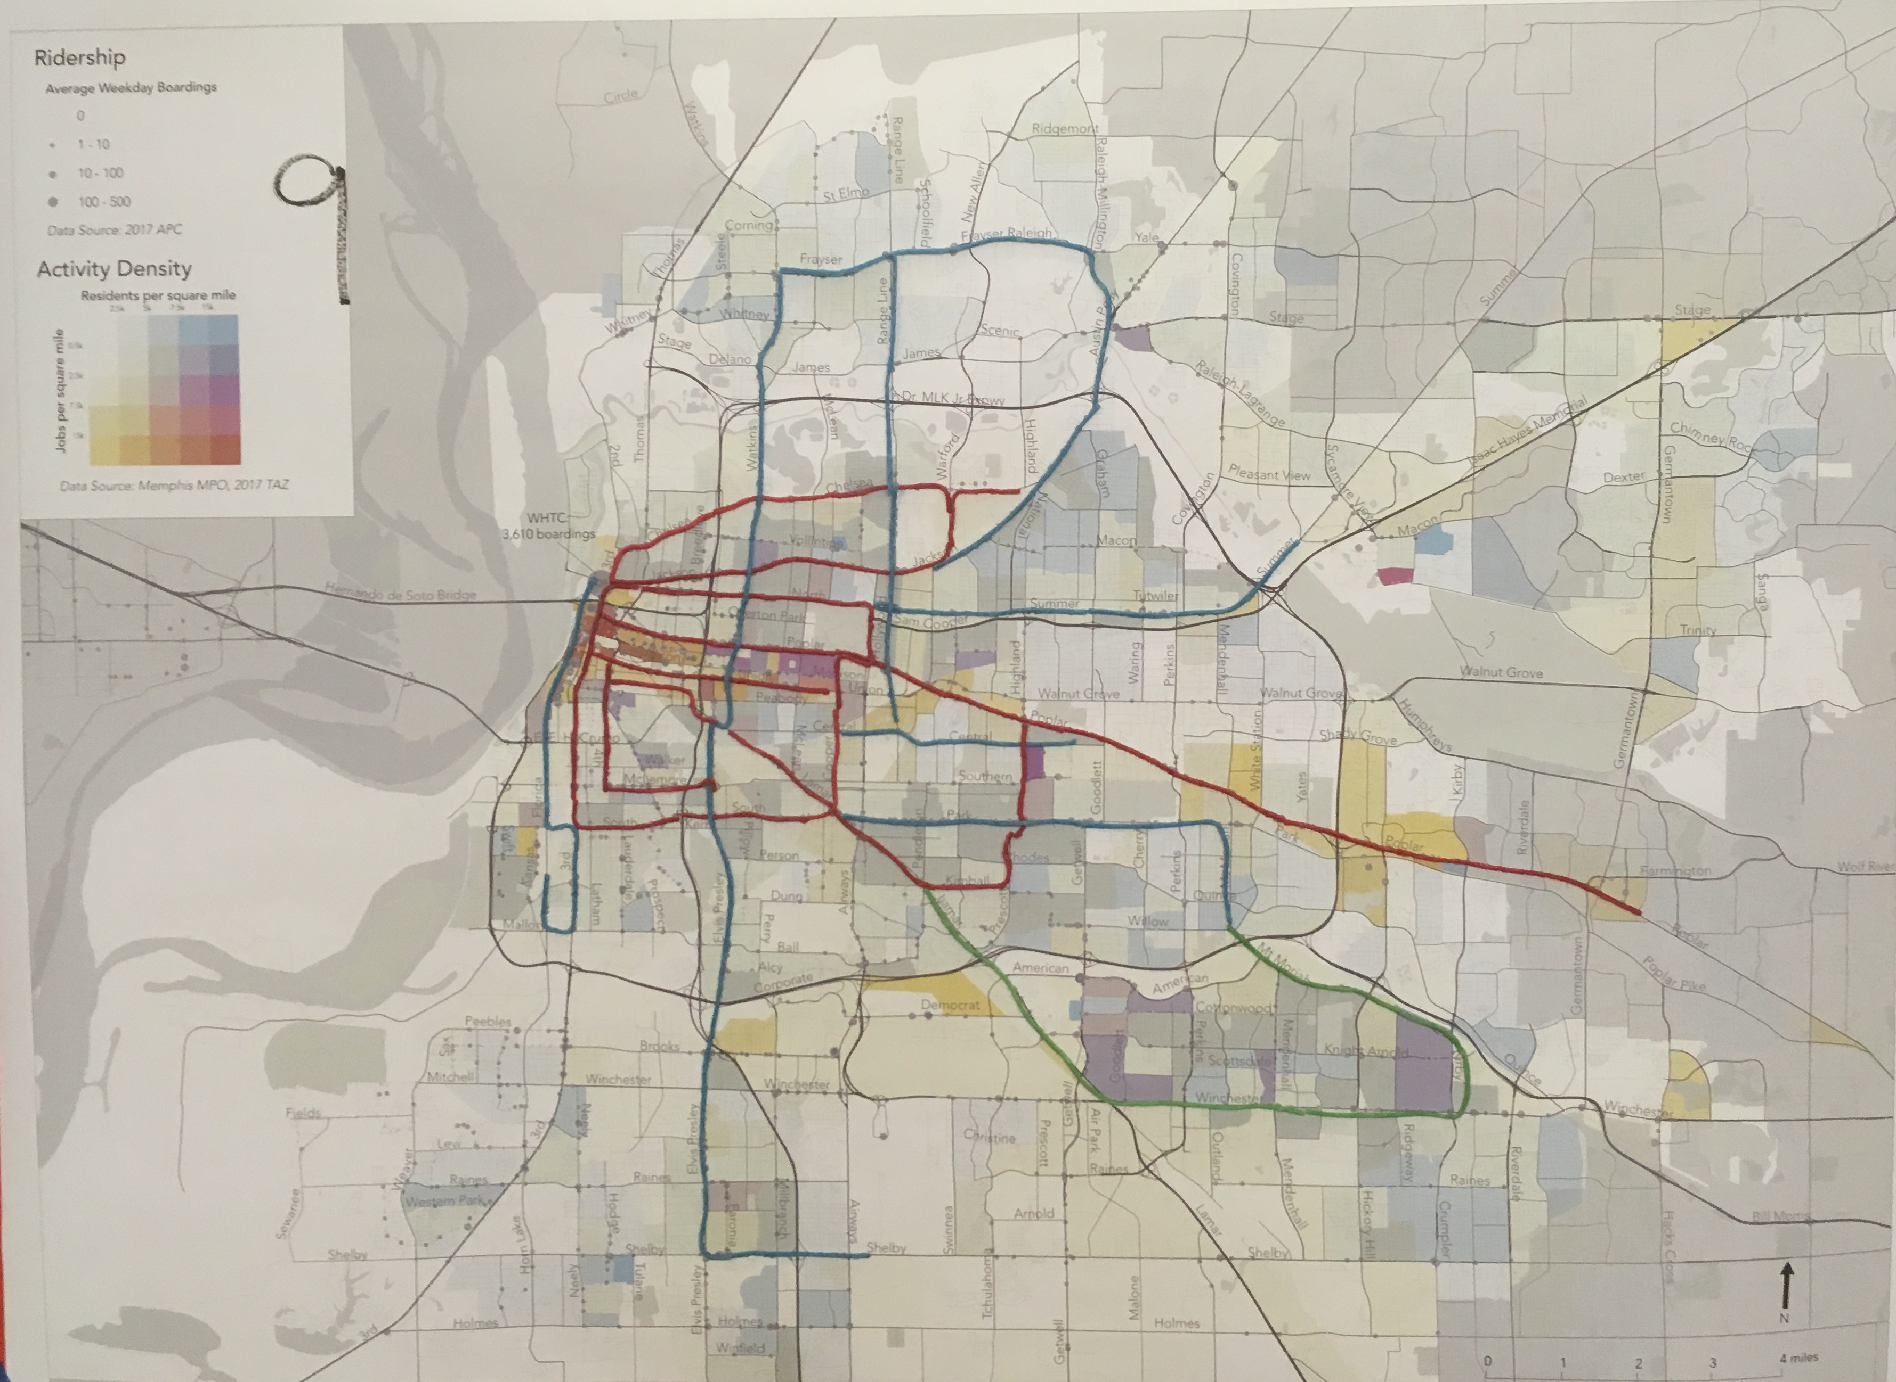

Slide 27
Key Choices

Slide 28
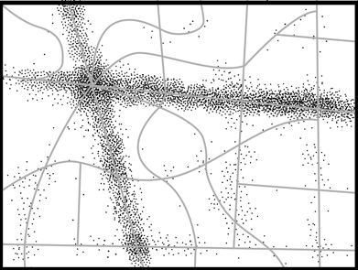
How should a transit agency allocate its resources?
Fictional Urban Area
Dots = residents and jobs
You have 18 buses
Notes:
Deleted previous slide as redundant. Will flash thru these fast as it’s all review.

Slide 29
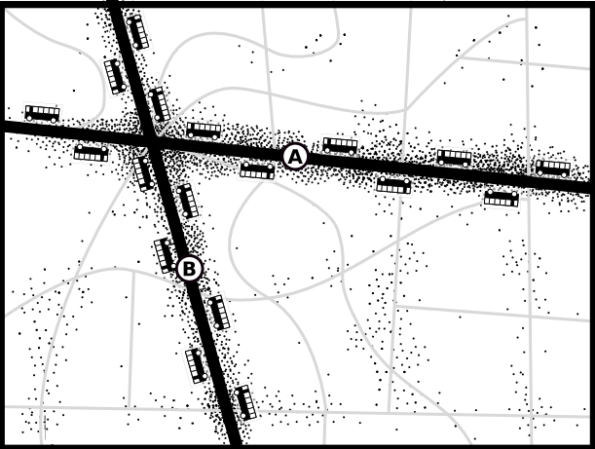
Ridership Goal
“Maximize Ridership”
To maximize ridership you think like a business, choosing which markets you will enter.
The straight lines offer density, walkability, and an efficient transit path, so you focus frequent, attractive service there.
Performance Measure: Ridership and Productivity
Ridership relative to cost

Slide 30
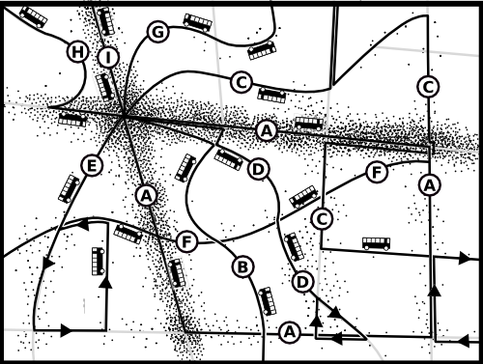
Coverage Goal
“Some service for everyone”
To maximize coverage, think like a government service. Try to serve everyone, even those in expensive-to-serve places.
You get more routes covering everyone, but less frequency, more complexity, and lower ridership.
Performance Measure: Coverage
% of residents and jobs near some service

Slide 31
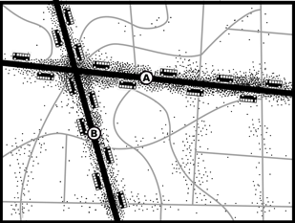
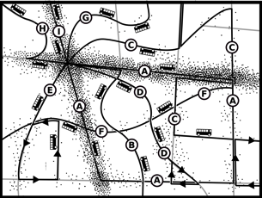
Both goals are important,
… but they lead opposite directions!
High Ridership
Frequency!
Think like a business!
High Coverage
Access for all!

Slide 32
Every transit agency has to choose a point on the spectrum…
High Ridership
Frequency!
Think like a business!
High Coverage
Access for all!
…explicitly or implicitly.

Slide 33
More waiting, or more walking?
Key Choice #1:

Slide 34

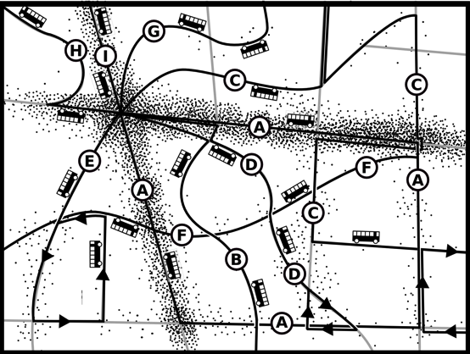
Ridership vs. coverage = walking vs. waiting

Slide 35
Waiting vs walking
The individual experience of frequency vs. coverage is walking vs. waiting
Concentrate service into fewer more frequent routes? Or…
Spread service out into more routes with long waits?
Notes:
“You can walk faster than you can wait”

Slide 36
Stakeholder Committee Responses

Slide 37
Public Responses

Slide 38
How to balance frequency and coverage for the city
Key Choice #2:

Slide 39
Stakeholder Committee Responses

Slide 40
Public Responses

Slide 41
How much service do you want?
Key Choice #3:

Slide 42
Does Memphis have enough transit service?
Adding more service would mean increasing frequency or coverage without cutting anyone’s existing service….
But service isn’t free!

Slide 43
Stakeholder Committee Responses

Slide 44
What should be done with any new service?
Key Choice #4:

Slide 45
Stakeholder Committee Responses

Slide 46
Public Responses

Slide 47
4 Future Concepts for Memphis

Slide 48
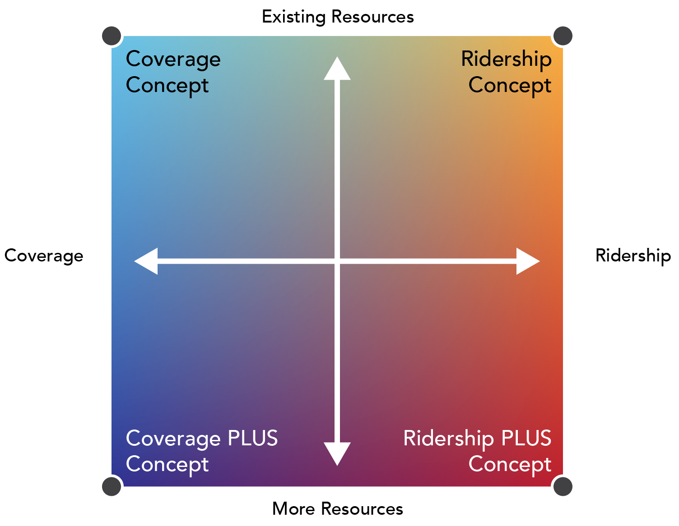

Slide 49
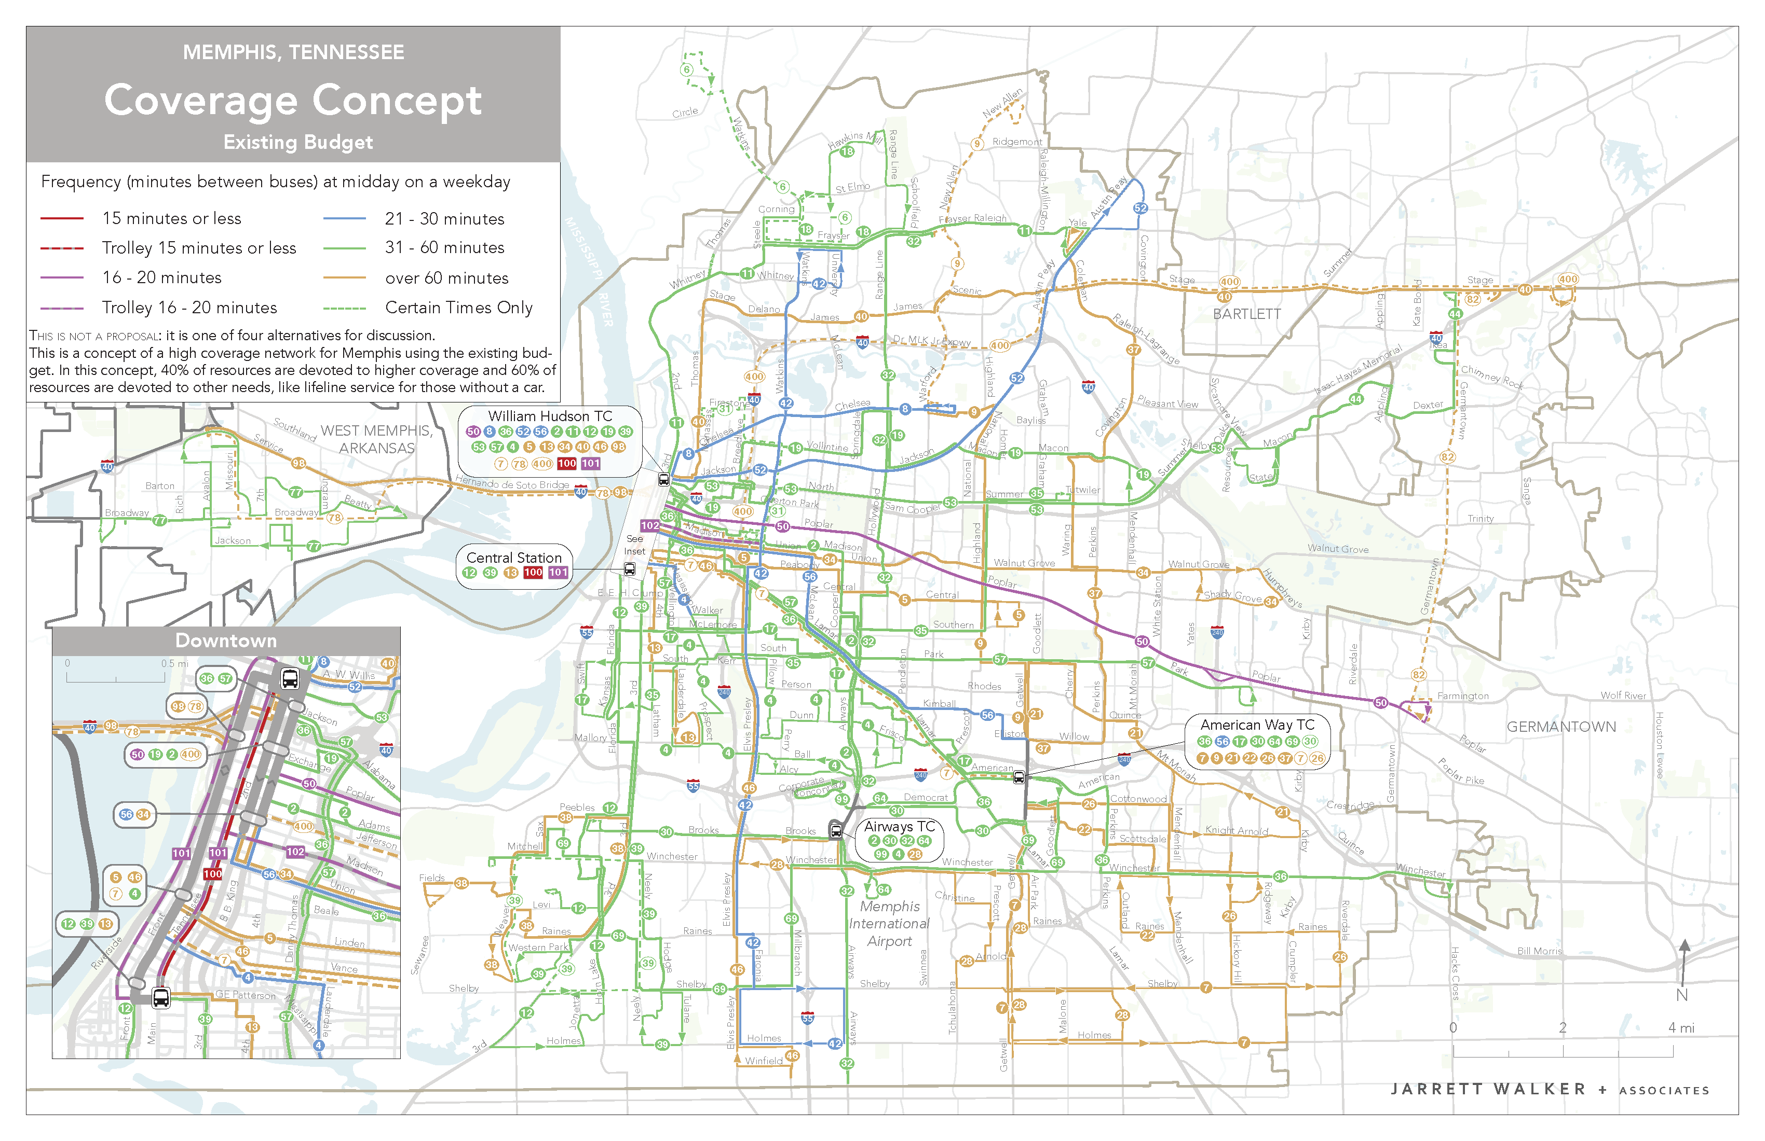

Slide 50
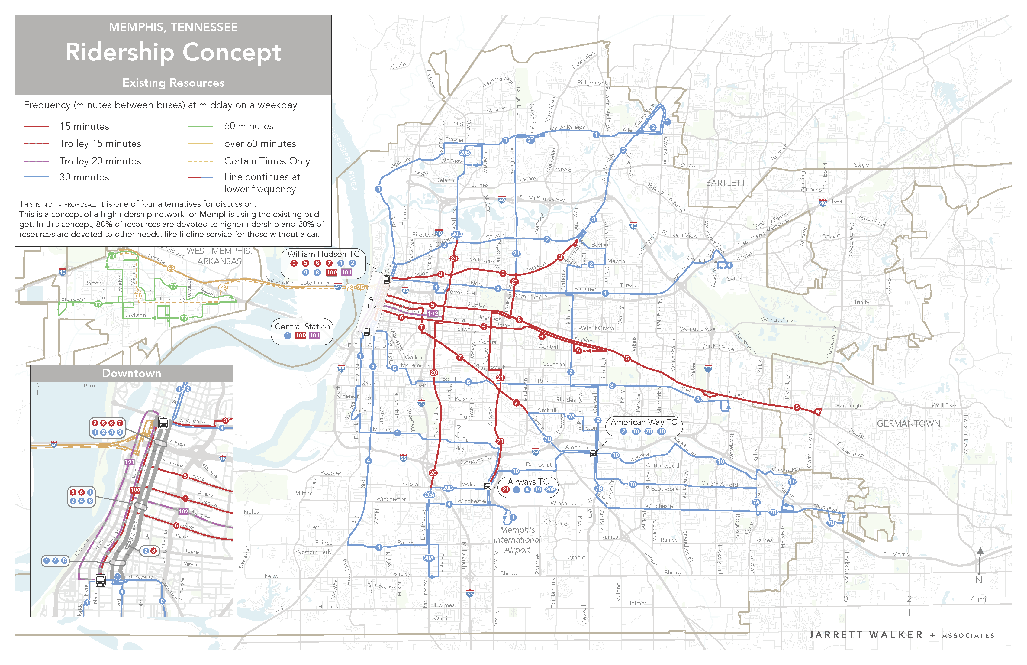

Slide 51
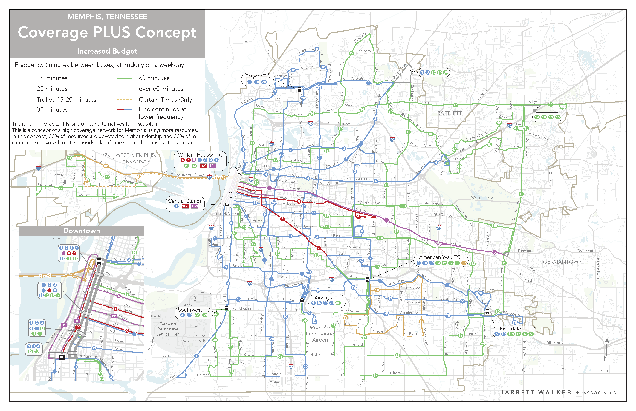

Slide 52
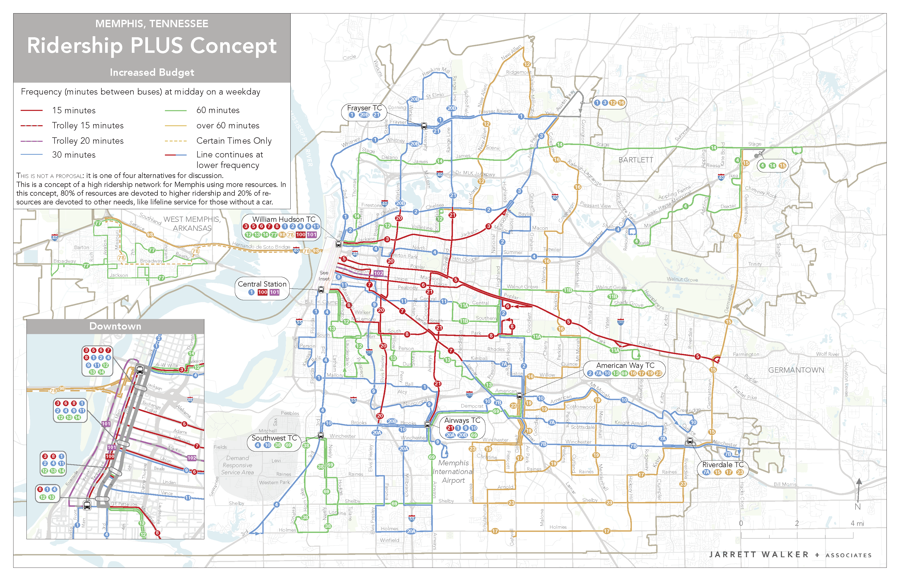

Slide 53
Isochrones

Slide 54
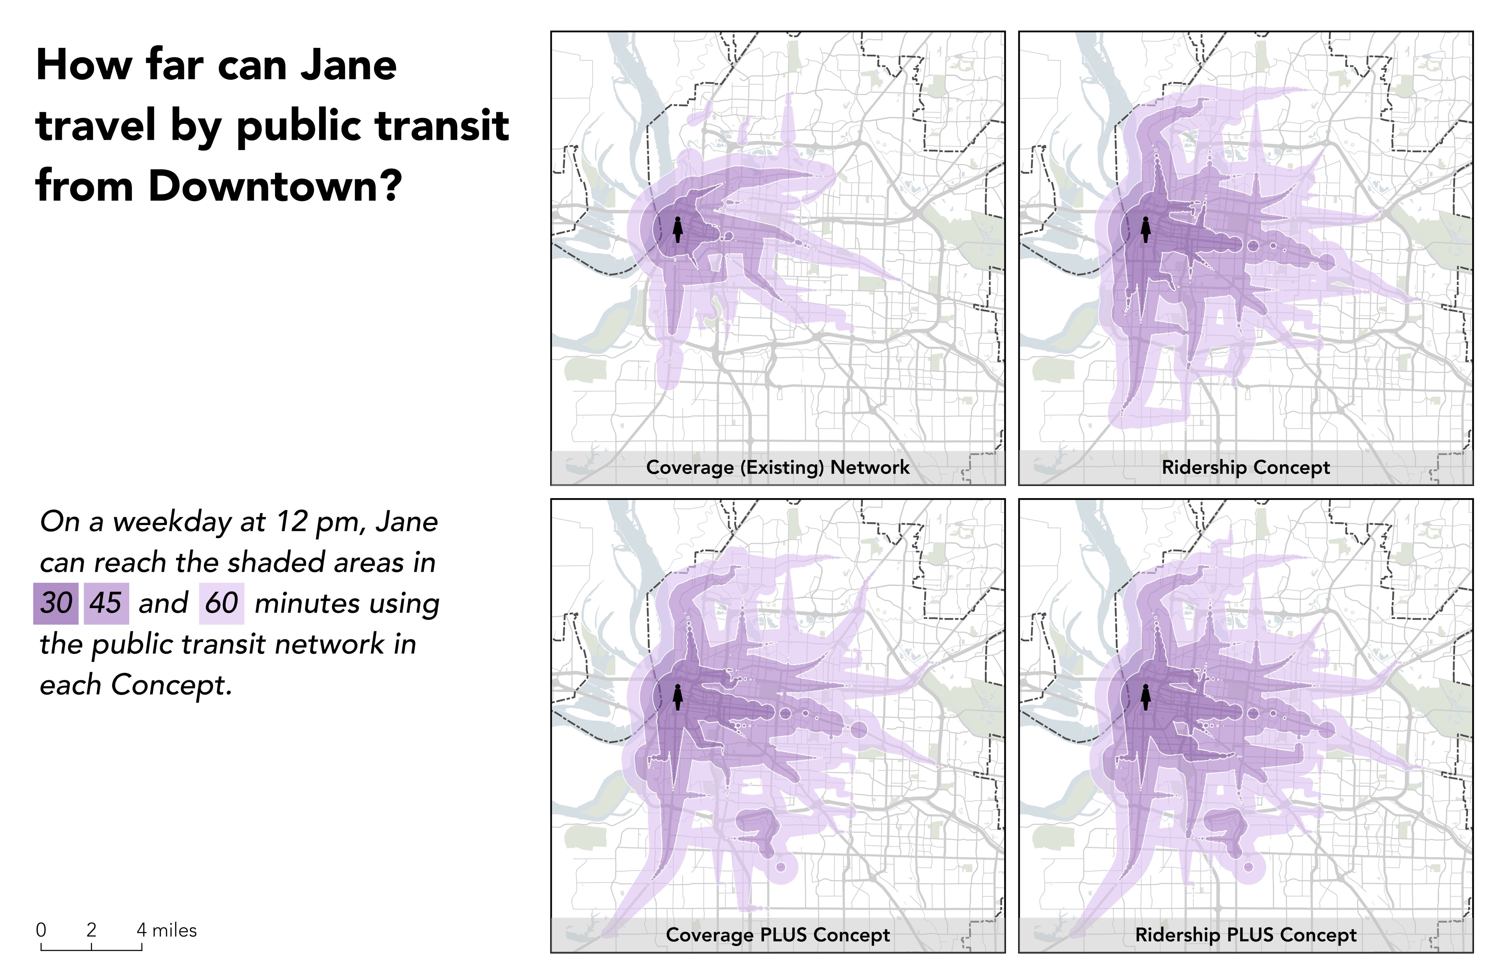

Slide 59
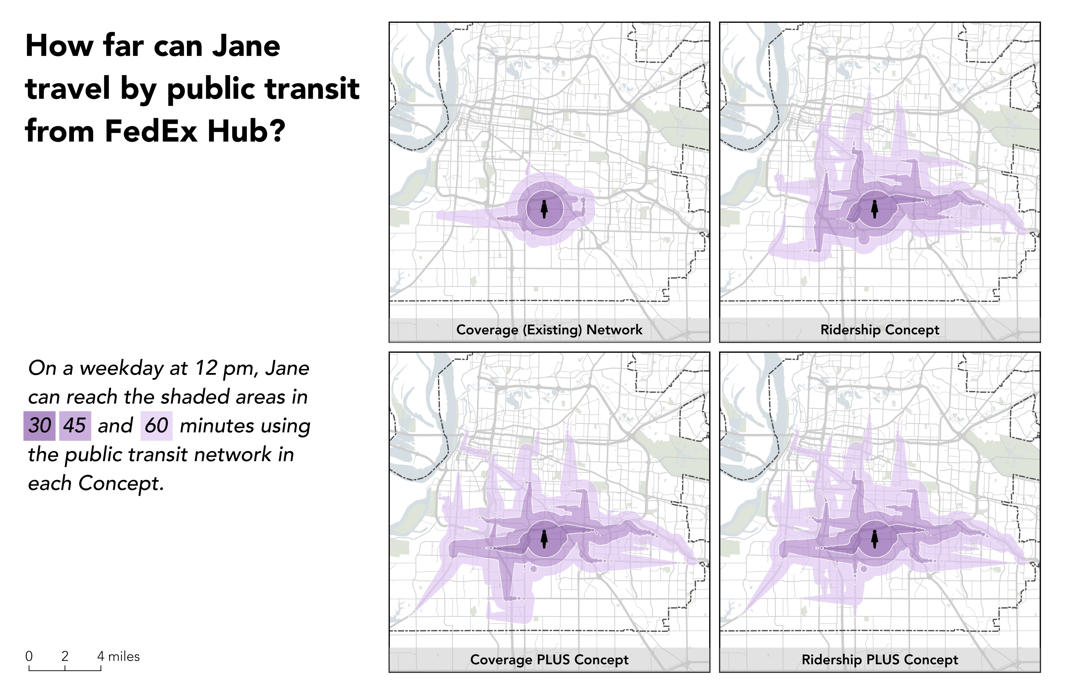

Slide 64
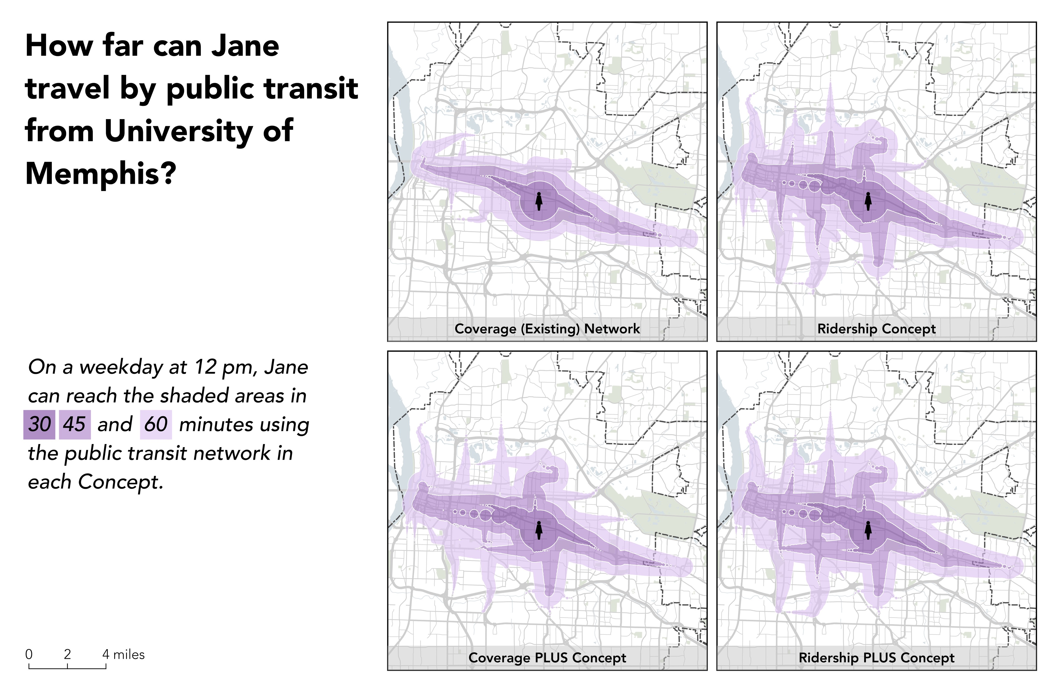

Slide 69
Coverage

Slide 70
How many residents have access to transit?

Slide 71
How many jobs are accessible by transit?

Slide 72
Discussion

Slide 73
Your preliminary input
At first glance, which of these Concepts serves your community’s values best?
You can change your mind!
We will ask you again in January.

Slide 74
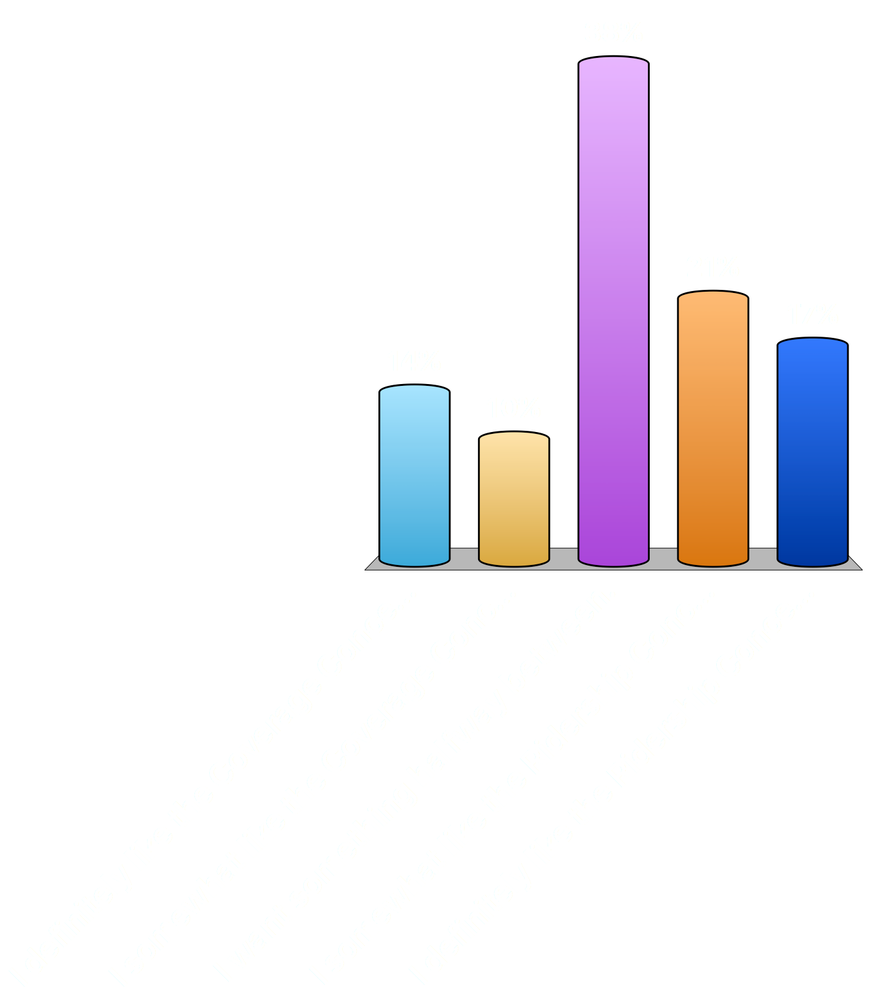
Comparing the Coverage and Ridership Concepts, if Memphis has no more funding for transit, which would you prefer?
I definitely like the Coverage Concept.
I somewhat like the Coverage Concept.
I want something halfway between.
I somewhat like the Ridership Concept.
I definitely like the Ridership Concept.

Slide 75
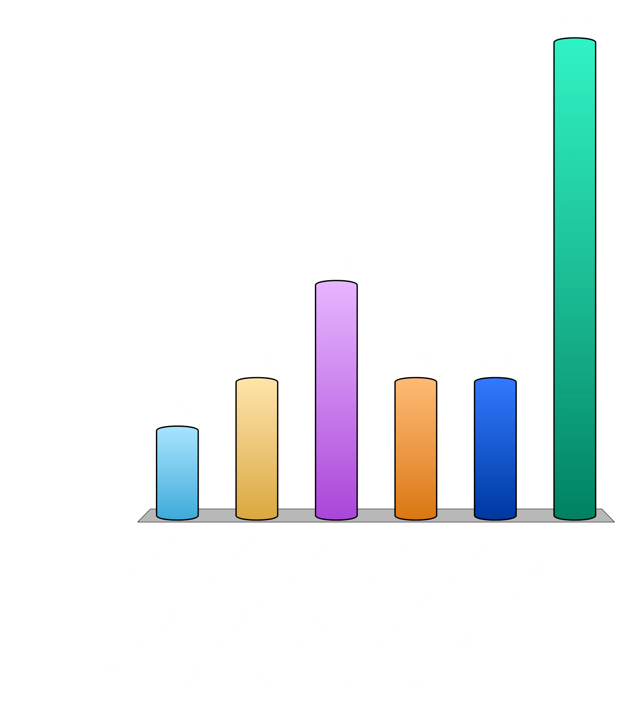
How much more in taxes per year would you be willing to pay for increased transit service?
None
$1 to $24 per year
$25 to $49 per year
$50 to $74 per year
$75 to $99 per year
$100 or more per year

Slide 76
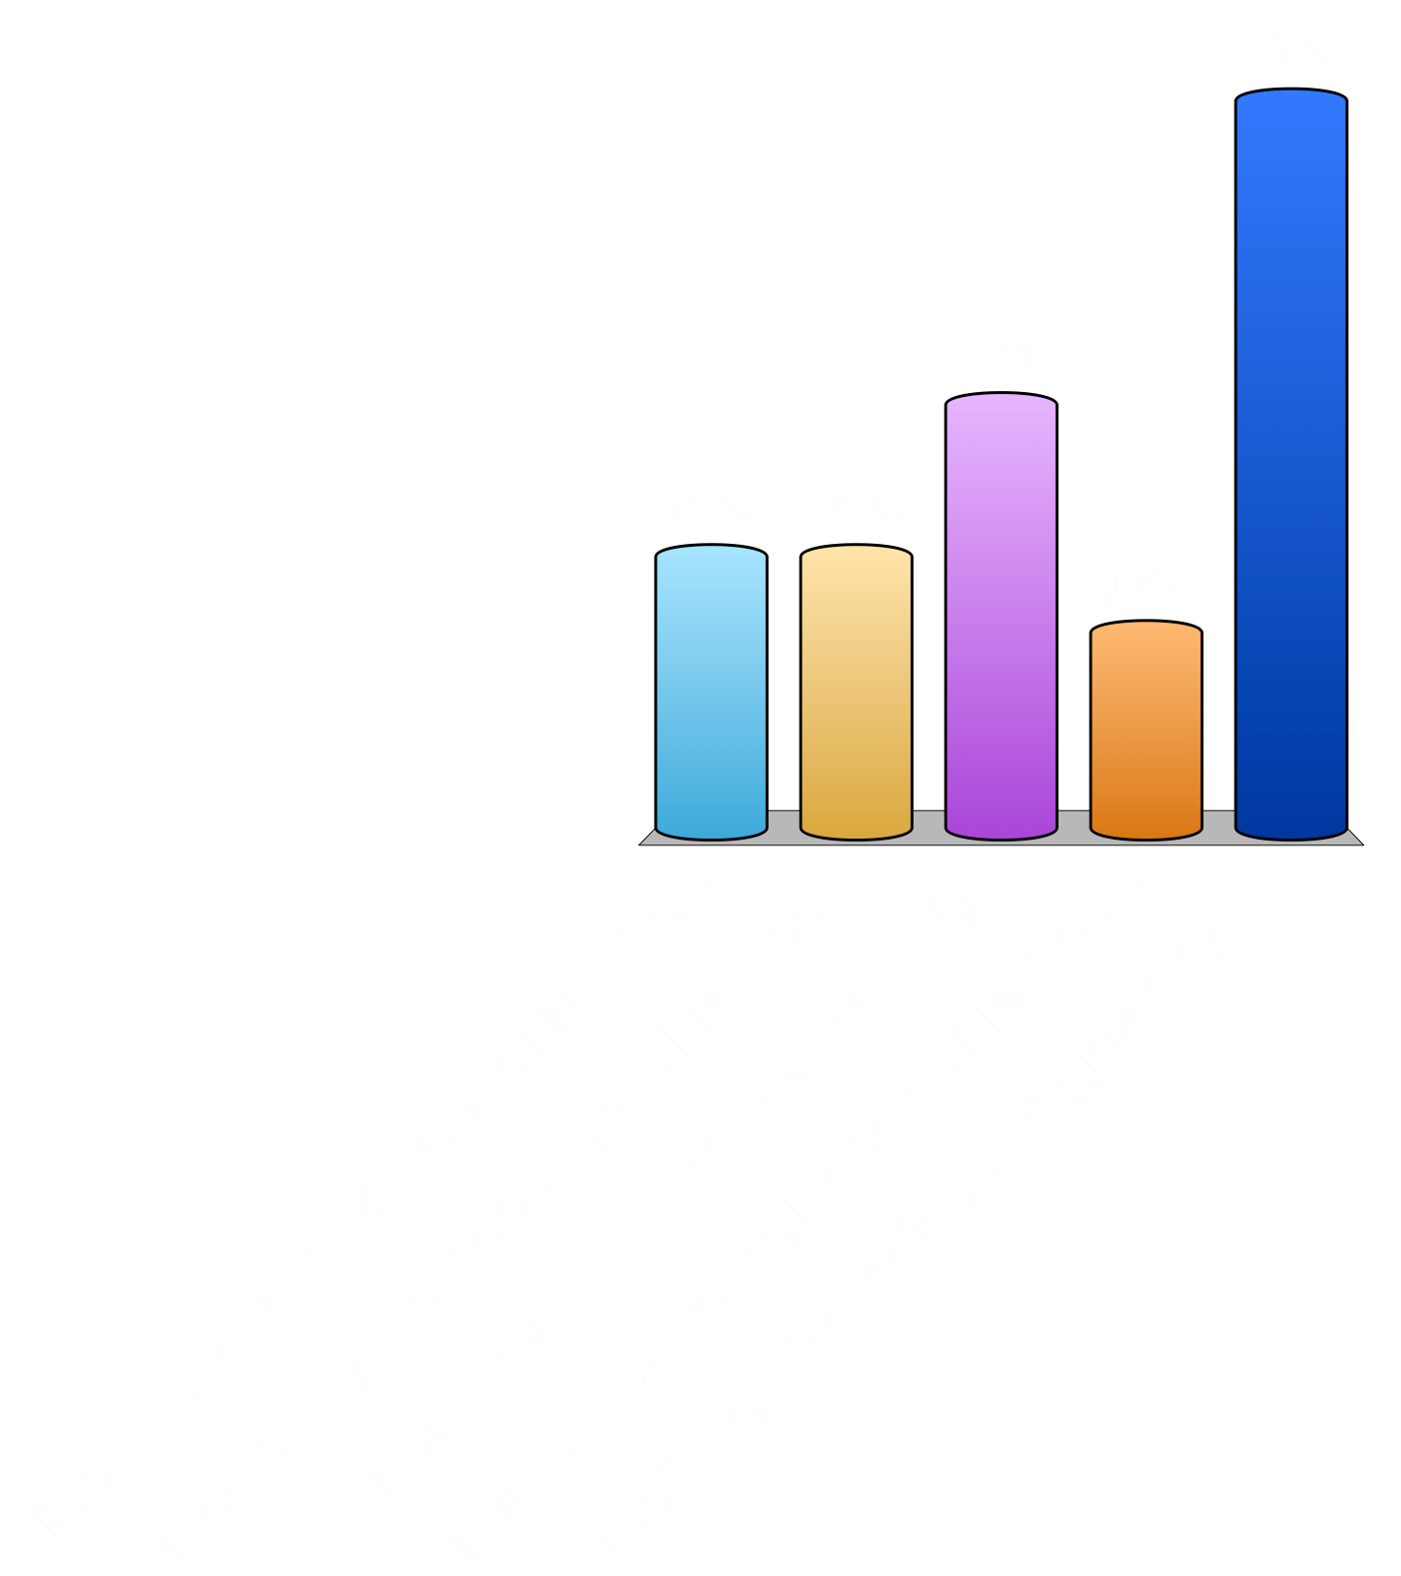
Comparing the Coverage PLUS and Ridership PLUS Concepts, if Memphis did have more funding for transit, which would you prefer?
I definitely like the Coverage PLUS Concept.
I somewhat like the Coverage PLUS Concept.
I want something halfway between.
I somewhat like the Ridership PLUS Concept.
I definitely like the Ridership PLUS Concept.

Slide 77
Public Outreach – can you help expand our reach?
  Should we table at an event?
  Should we add someone to the email list?
  Should we speak to a group?
  Email scarlson@innovatememphis.com

Slide 78
What’s next?
Conceptual Alternatives Report published this week.
  We will email you a link!
Web and paper surveys over the next few weeks.
We will follow up with a second round of questions about these concepts in January.
Please talk to your communities about these concepts!
A third meeting for you in February or March 2018.

Slide 79
Thank You!

Slide 80
EXTRA SLIDES

Slide 81
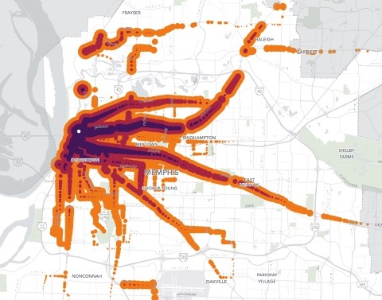
“Isochrone”: a map of your freedom
Iso means “same”
chrone means “time”
Notes:
Includes walking, waiting, riding, transferring, etc.

Slide 82
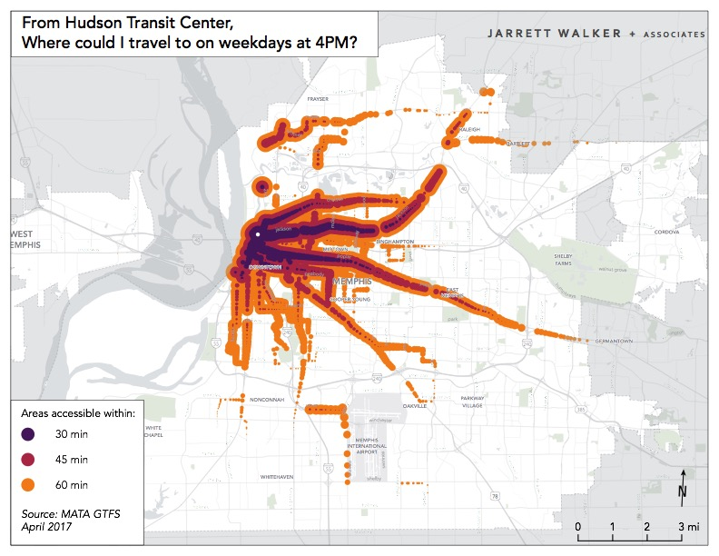
Notes:
Explain how little would be different if the question were, “Where could I travel to by 5 pm?” Waiting happens either way.

Slide 83
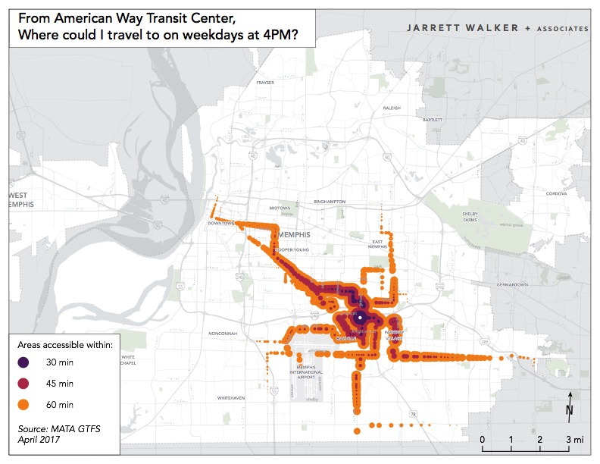

Slide 84
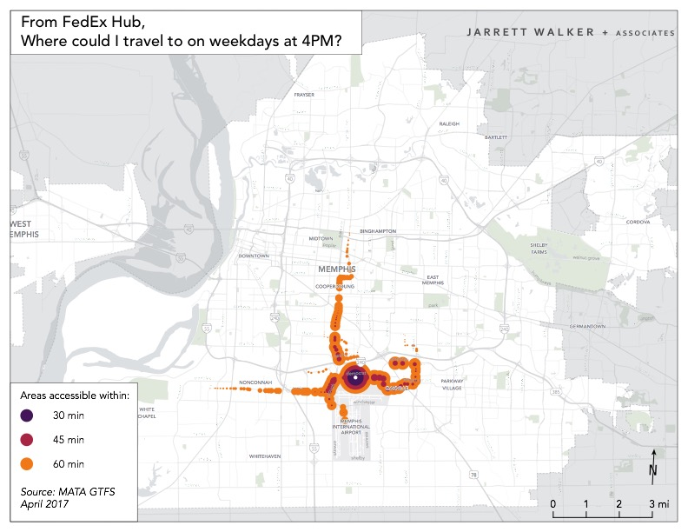

Slide 85
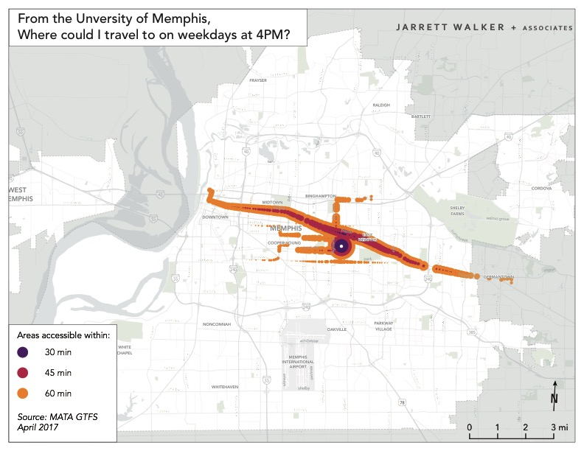

Slide 86
What if we tried to grow these blobs?
Not just the area, but also the stuff inside them.
“What % of the city’s jobs, friends, housing, schooling, worship, culture, is available to me?”
“How free am I to access the riches of the city?”
Also, growing isochrones for large numbers of people is a pretty good way to grow ridership!

